Slide 1
Cornerstone City Church Peninsula Plus Community Hoo Are Ya
13th April 2025

Slide 2
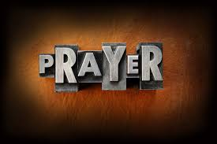

Slide 3
Glorious Day
CCLI Song # 7081388
Jason Ingram | Jonathan Smith | Kristian Stanfill | Sean Curran
© 2017 KPS 1.0 (Admin. by Capitol CMG Publishing)
sixsteps Music (Admin. by Capitol CMG Publishing)
sixsteps Songs (Admin. by Capitol CMG Publishing)
Sounds Of Jericho (Admin. by Capitol CMG Publishing)
Worship Together Music (Admin. by Capitol CMG Publishing)
worshiptogether.com songs (Admin. by Capitol CMG Publishing)
Fellow Ships Music (Admin. by Essential Music Publishing LLC)
Hickory Bill Doc (Admin. by Essential Music Publishing LLC)
So Essential Tunes (Admin. by Essential Music Publishing LLC)
For use solely with the SongSelect® Terms of Use. All rights reserved. www.ccli.com
CCLI Licence No. 33265

Slide 4
1/6
I was buried beneath my shame
Who could carry that kind of weight
It was my tomb 'til I met You

Slide 5
2/6
I was breathing but not alive
All my failures I tried to hide
It was my tomb 'til I met You

Slide 6
3/6
('Cause when) You called my name (and)
I ran out of that grave
Out of the darkness into Your glorious day
You called my name (and) I ran out of that grave
Out of the darkness into Your glorious day

Slide 7
4/6
Now Your mercy has saved my soul
Now Your freedom is all that I know
The old made new Jesus when I met You

Slide 8
5/6
I needed rescue my sin was heavy
But chains break at the weight of Your glory
I needed shelter I was an orphan
Now You call me a citizen of Heaven
When I was broken You were my healing
Now Your love is the air that I'm breathing
I have a future my eyes are open

Slide 9
6/6
('Cause when) You called my name (and)
I ran out of that grave
Out of the darkness into Your glorious day
You called my name (and)
I ran out of that grave
Out of the darkness into Your glorious day

Slide 10
Open The Eyes of My Heart
CCLI Song # 2298355
Paul Baloche
© 1997 Integrity's Hosanna! Music (Admin. by Integrity Music Ltd)
For use solely with the SongSelect® Terms of Use. All rights reserved. www.ccli.com
CCLI Licence No. 33265

Slide 11
1/3
Open the eyes of my heart Lord
Open the eyes of my heart
I want to see You
I want to see You

Slide 12
2/3
To see You high and lifted up
Shining in the light of Your glory
Pour out Your power and love
As we sing holy holy holy

Slide 13
3/3
Holy holy holy
Holy holy holy
Holy holy holy
I want to see You

Slide 15
Firm Foundation (He Won't)
CCLI Song # 7188203
Austin Davis | Chandler Moore | Cody Carnes
© 2021 For Humans Publishing (Admin by Essential Music Publishing)
Maverick City Publishing (Admin by Essential Music Publishing)
Capitol CMG Paragon (Admin. by Capitol CMG Publishing)
TBCO Publishing (Admin. by Capitol CMG Publishing)
Writer's Roof Publishing (Admin. by Capitol CMG Publishing)
A.L.K.D. Music (Admin. by Watershed Music Group (Admin. by Capitol CMG Publishing))
For use solely with the SongSelect® Terms of Use. All rights reserved. www.ccli.com
CCLI Licence No. 33265

Slide 16
1/7
Christ is my firm foundation
The rock on which I stand
When everything around me is shaken
I've never been more glad
That I put my faith in Jesus
'Cause He's never let me down
He's faithful through generations
So why would He fail now

Slide 17
2/7
He won’t
He won't

Slide 18
3/7
I've still got joy in chaos
I've got peace that makes no sense
So I won't be going under
I'm not held by my own strength
'Cause I've built my life on Jesus
He's never let me down
He's faithful in every season
So why would He fail now

Slide 19
4/7
He won’t He won't
He won't fail
He won't fail

Slide 20
5/7
Rain came and wind blew
My house was built on You
I'm safe with You
I'm going to make it through

Slide 21
6/7
I'm going to make it through
‘Cause I’m standing strong on You
I’m going to make it through
‘Cause my house is built on You

Slide 22
7/7
Christ is my firm foundation
The rock on which I stand
When everything around me is shaken
I've never been more glad
That I put my faith in Jesus
'Cause He's never let me down
He's faithful through generations
So why would He fail now

Slide 24
Living Hope CCLI Song # 7106807
Brian Johnson | Phil Wickham
© 2017 Phil Wickham Music; Simply Global Songs; Sing My Songs; Bethel Music Publishing
For use solely with the SongSelect® Terms of Use. All rights reserved. www.ccli.com
CCLI Licence No. 33265

Slide 25
1/6
How great the chasm that lay between us
How high the mountain I could not climb
In desperation I turned to heaven
And spoke Your name into the night
Then through the darkness Your loving-kindness
Tore through the shadows of my soul
The work is finished the end is written
Jesus Christ my living hope

Slide 26
2/6
Who could imagine so great a mercy
What heart could fathom such boundless grace
The God of ages stepped down from glory
To wear my sin and bear my shame
The cross has spoken I am forgiven
The King of kings calls me His own
Beautiful Savior I’m Yours forever
Jesus Christ my living hope

Slide 27
3/6
Hallelujah praise the One who set me free
Hallelujah death has lost its grip on me
You have broken every chain
There’s salvation in Your name
Jesus Christ my living hope

Slide 28
4/6
Then came the morning that sealed the promise
Your buried body began to breathe
Out of the silence the Roaring Lion
Declared the grave has no claim on me
(REPEAT)
Jesus Yours is the victory whoa

Slide 29
5/6
Hallelujah praise the One who set me free
Hallelujah death has lost its grip on me
You have broken every chain
There’s salvation in Your name
Jesus Christ my living hope

Slide 30
6/6
Jesus Christ my living hope
Oh God You are my living hope

Slide 32
How Great Thou Art
CCLI Song # 14181
Stuart Wesley Keene Hine
© Copyright 1949 and 1953 Stuart Hine Trust CIO Stuart K. Hine Trust
For use solely with the SongSelect® Terms of Use. All rights reserved. www.ccli.com
CCLI Licence No. 33265

Slide 33
1/5
Verse 1
O Lord my God when I in awesome wonder
Consider all the works Thy hand hath made
I see the stars I hear the mighty thunder
Thy pow'r throughout the universe displayed

Slide 34
2/5
Chorus
Then sings my soul my Saviour God to Thee
How great Thou art how great Thou art
Then sings my soul my Saviour God to Thee
How great Thou art how great Thou art

Slide 35
3/5
Verse 2
When through the woods and forest glades I wander
And hear the birds sing sweetly in the trees
When I look down from lofty mountain grandeur
And hear the brook and feel the gentle breeze

Slide 36
4/5
Verse 3
And when I think that God His Son not sparing
Sent Him to die I scarce can take it in
That on the Cross my burden gladly bearing
He bled and died to take away my sin

Slide 37
5/5
Verse 4
When Christ shall come with shout of acclamation
And take me home what joy shall fill my heart
Then shall I bow in humble adoration
And there proclaim my God how great Thou art

Slide 38


Slide 39


Slide 40
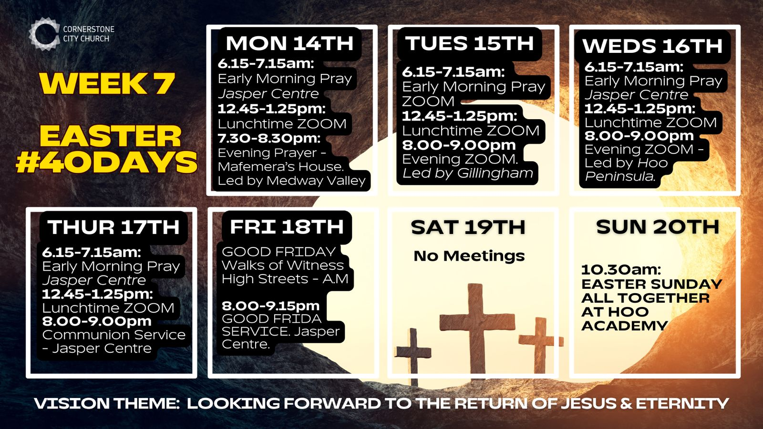
https://files.logoscdn.com/v1/files/83654762/assets/16863512/content.png?signature=ME1eOBr43tL81FDNTDJrm0TIp3M

Slide 41


Slide 42


Slide 43
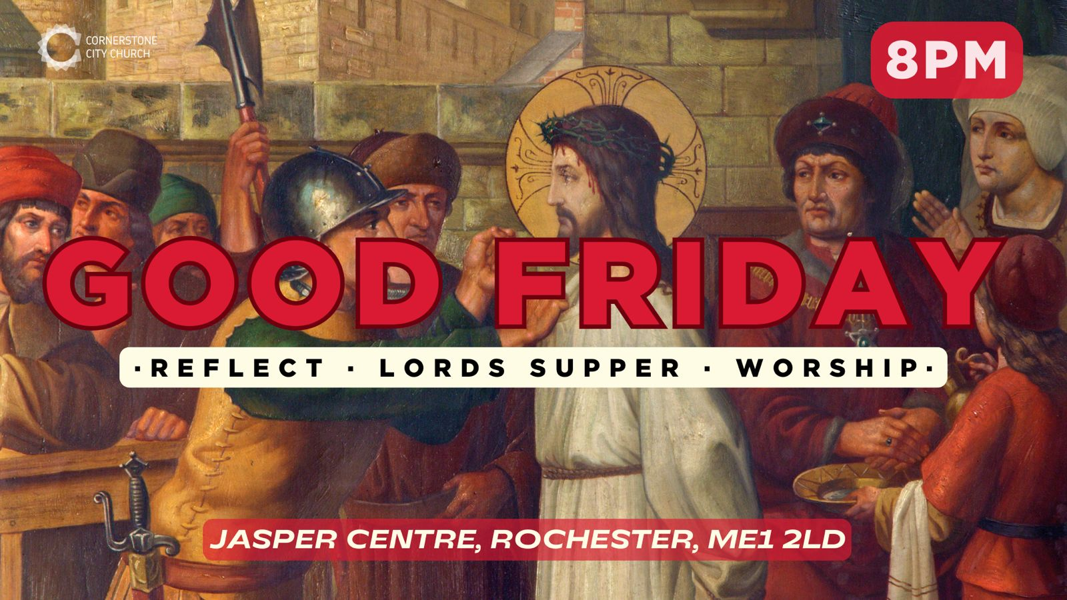

Slide 44
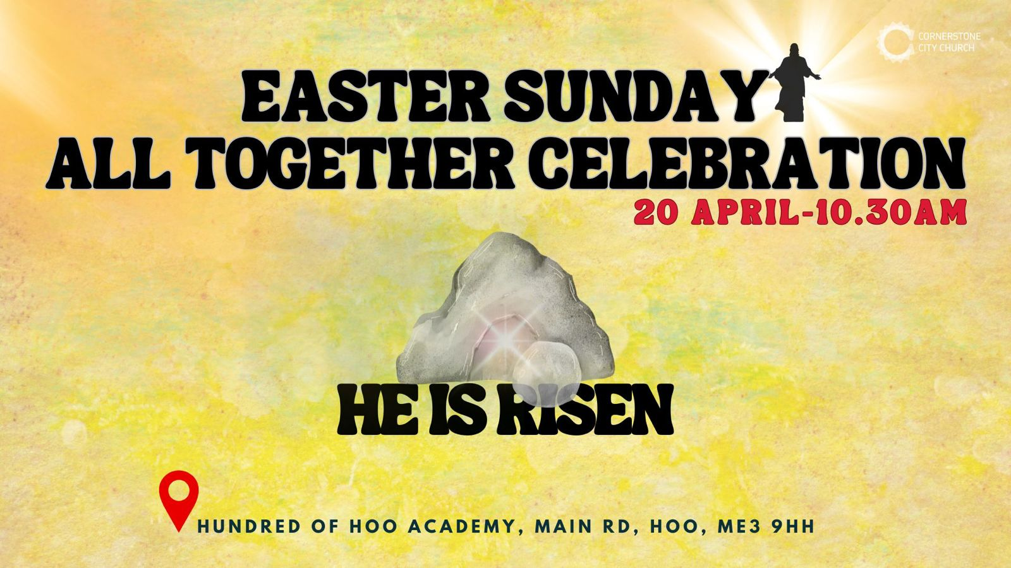

Slide 45


Slide 46


Slide 47
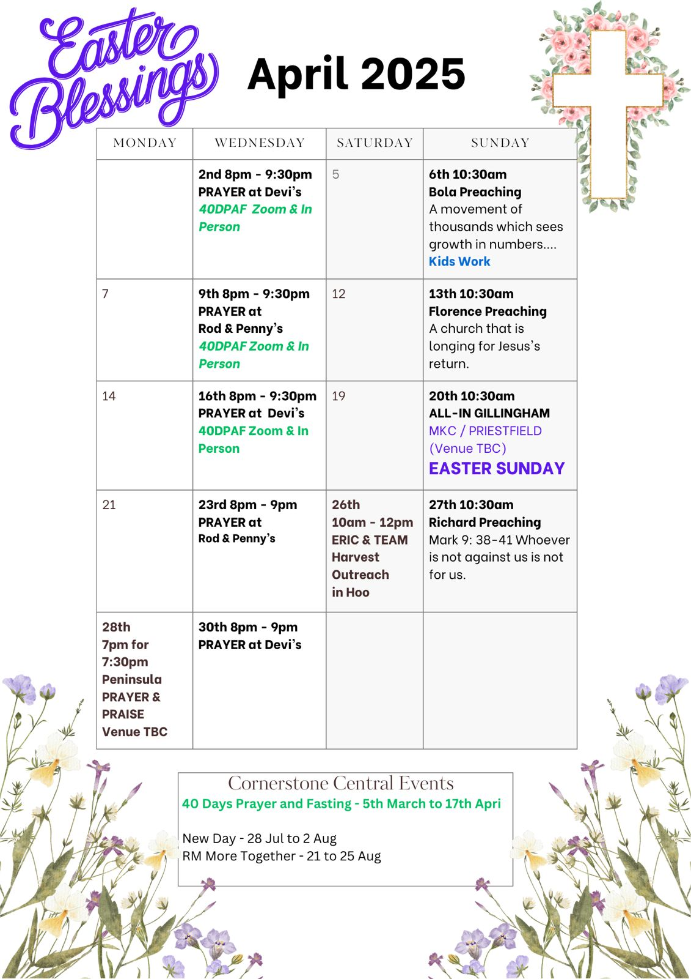

Slide 48

Grow Group 1
On YOUR MARK!

Slide 49
Leaders
Leaderss
Phil & Kim
Maria (Mia) Warren
Matthew Harrison
Richard & Elisha Acheampong
Phil & Kim
Maria (Mia) Warren
Matthew Harrison
Richard & Elisa Acheampong

Slide 50
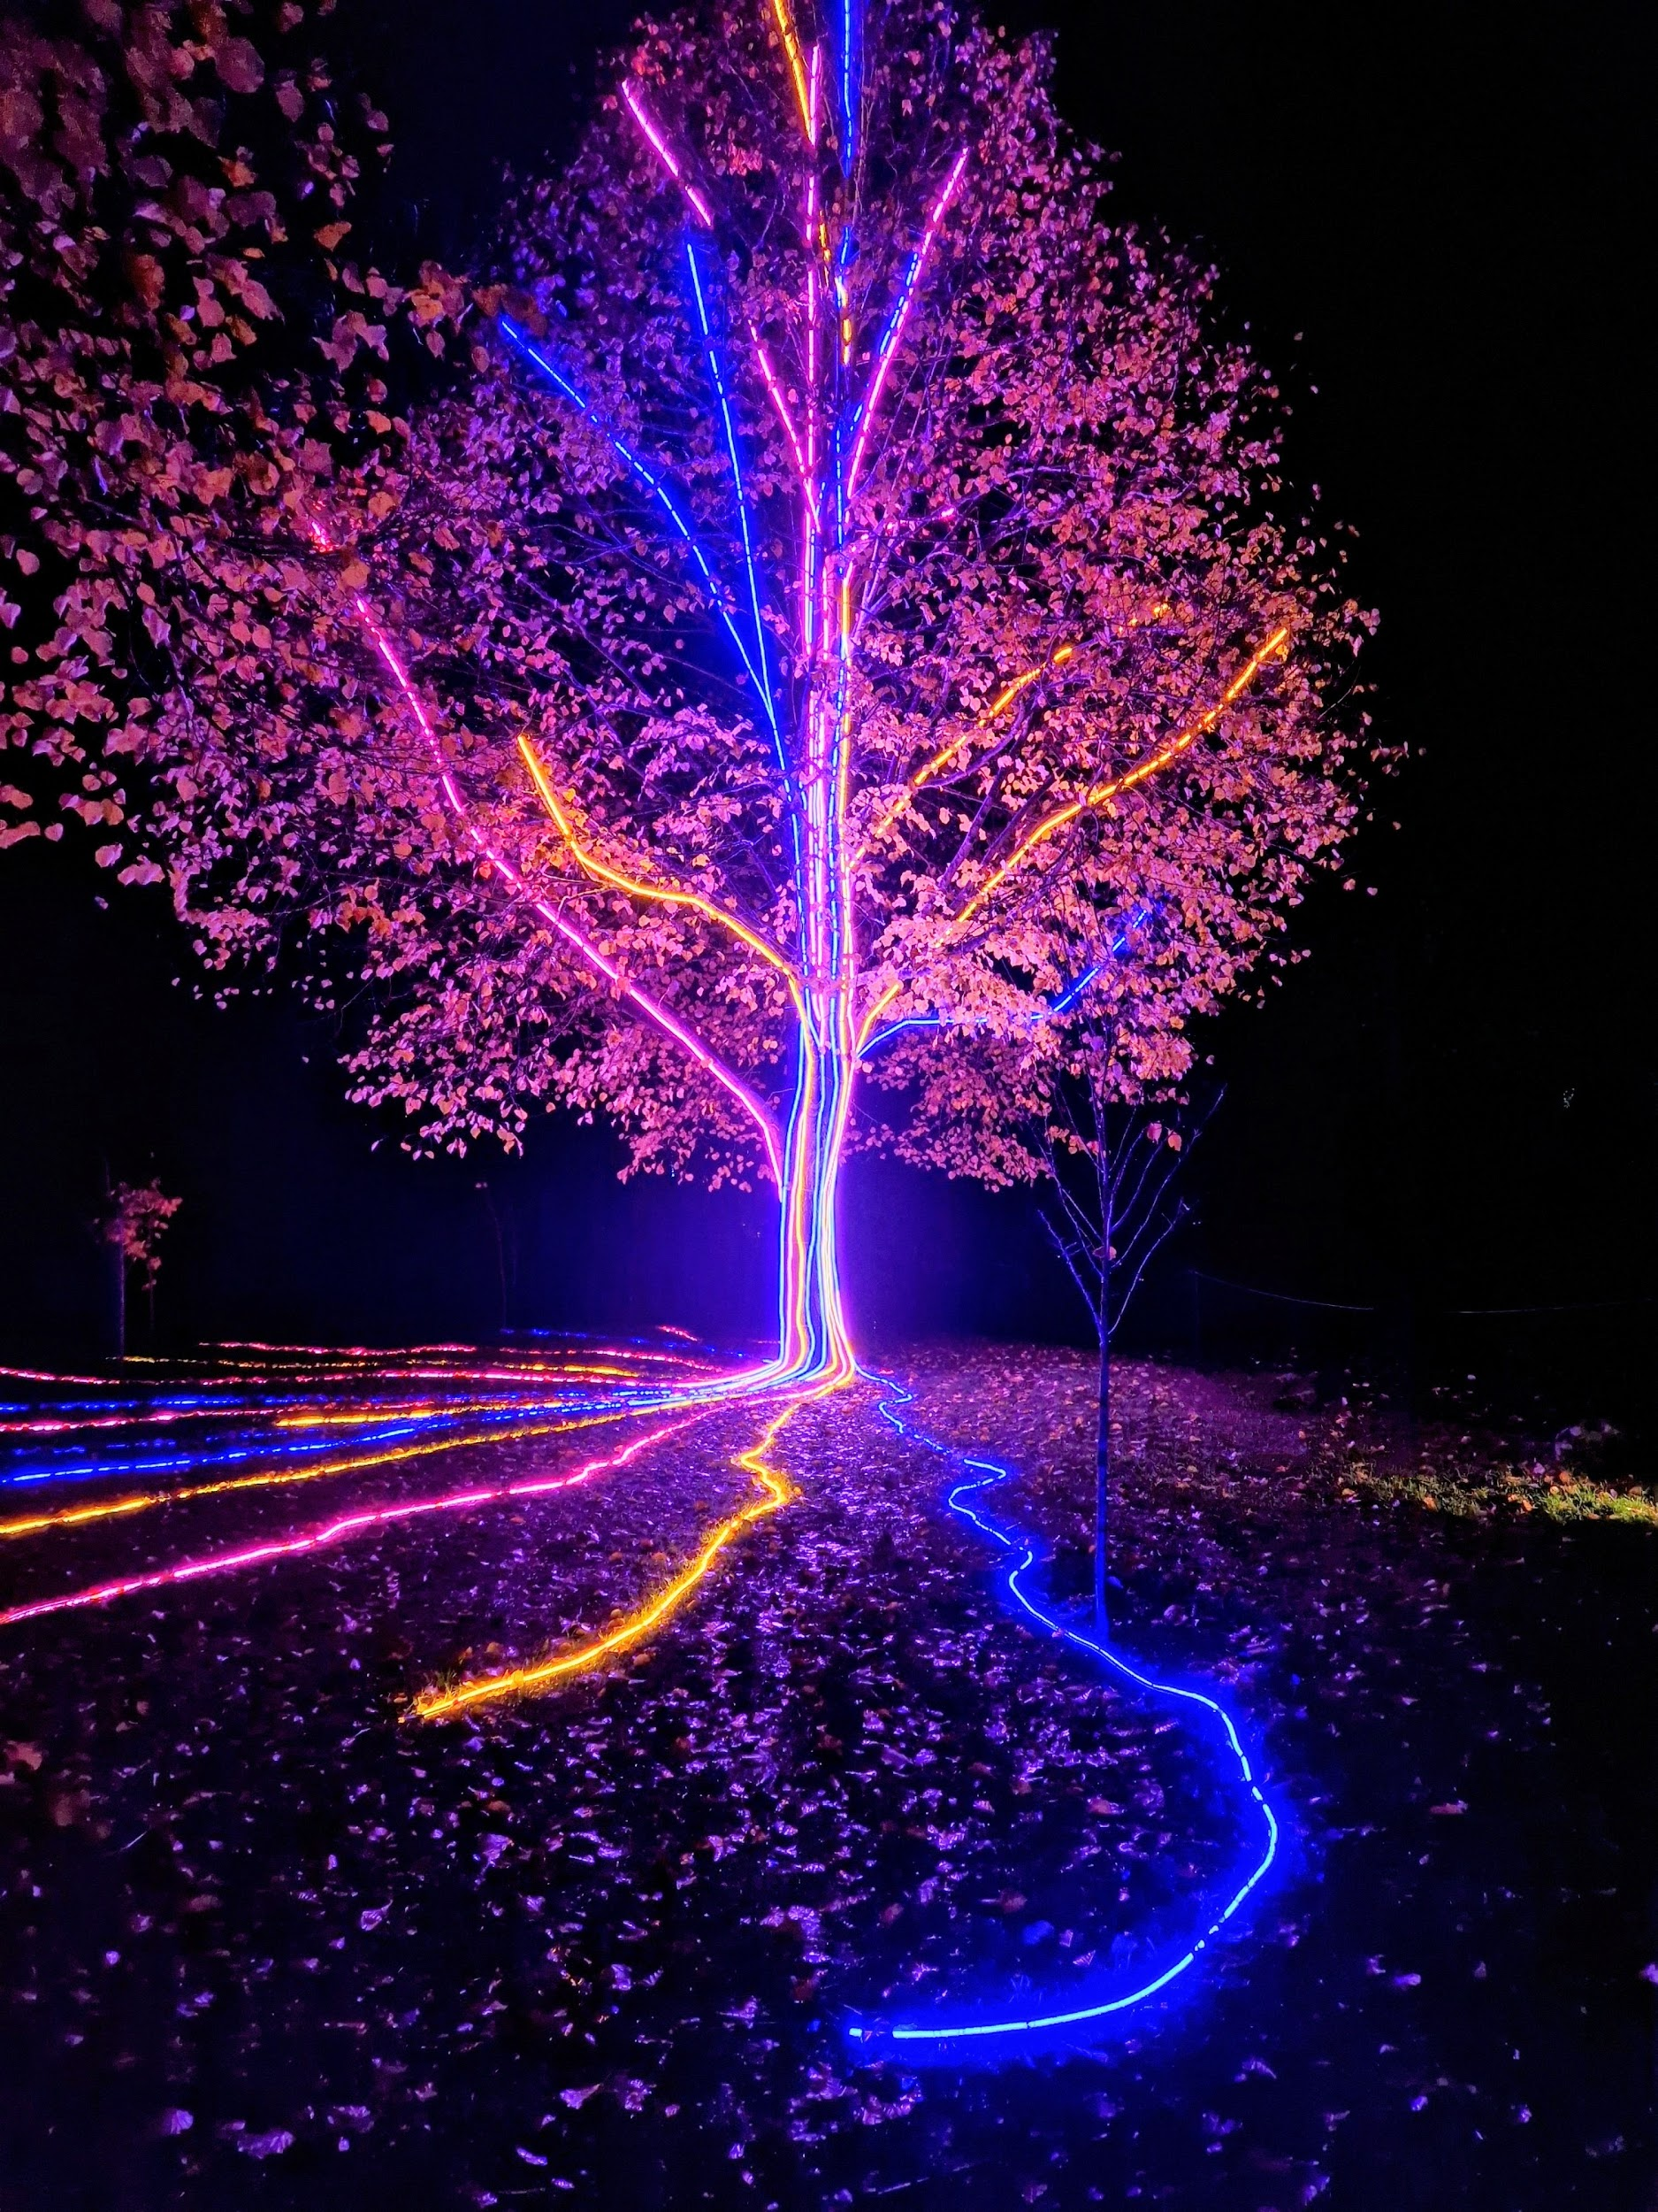
Storm Walker
Storm Walker
Symbolising, trust in Jesus Christ through life's storms.
Mark 4:35-41

Slide 51
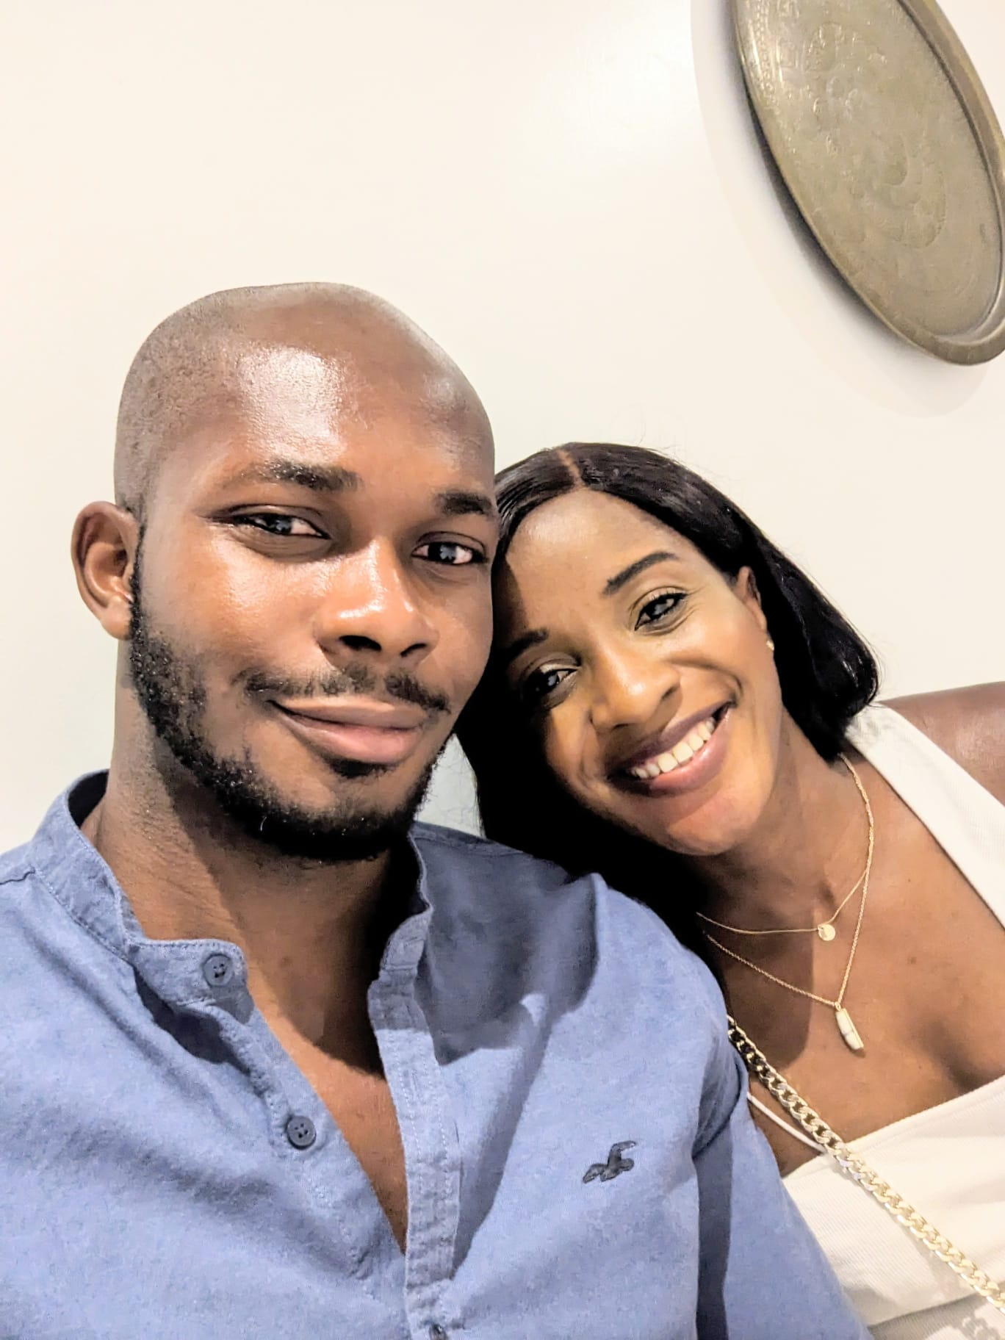

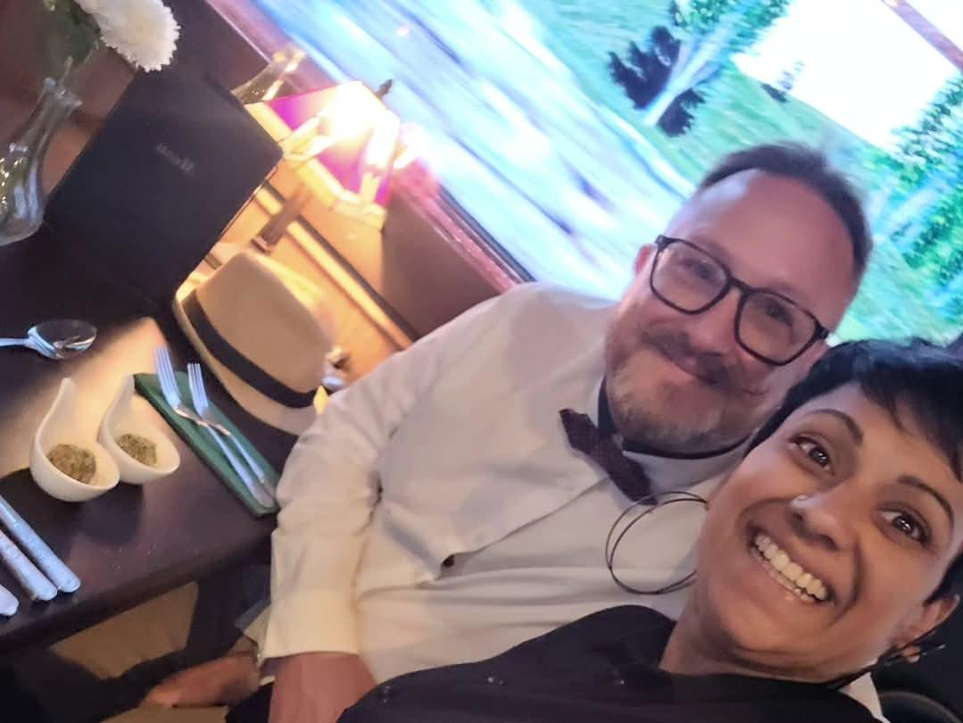
Group Leaders
Micheal and Mwamba
Wilfred and Parveen
Hannah

Slide 52


Slide 53
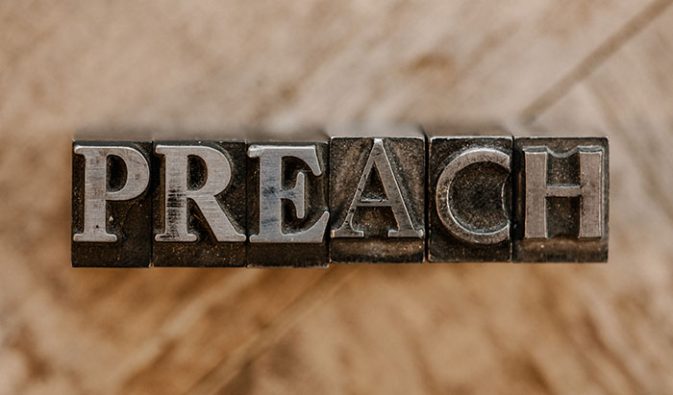

Slide 54
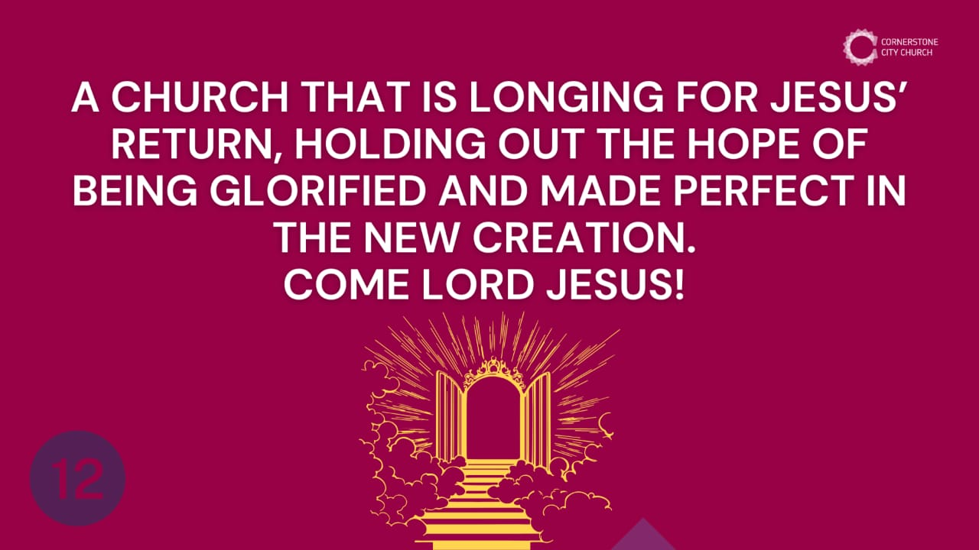

Slide 55
Reveleation 1:7 (NIV)
‘Look, he is coming with the clouds,’
and ‘every eye will see him,
even those who pierced him’;
and all peoples on earth ‘will mourn because of him.’
So shall it be! Amen.

Slide 56
Amplified Bible
⁷ Behold, He is coming with the clouds, and every eye will see Him, even those who pierced Him; and all the tribes (nations) of the earth will mourn over Him [realizing their sin and guilt, and anticipating the coming wrath]. ^{[k]}So it is to be. Amen.

Slide 58


Slide 59
Heb 12: 22-24 (NIV)
22 You have now come to Mount Zion and to the heavenly Jerusalem. This is the city of the living God, where thousands and thousands of angels have come to celebrate. 23 Here you will find all of God's dearest children,[e] whose names are written in heaven. And you will find God himself, who judges everyone. Here also are the spirits of those good people who have been made perfect. 24 And Jesus is here!

Slide 60
1. With Planning and Preparation
Matt 25: 13
So, my disciples, always be ready! You don't know the day or the time when all this will happen.

Slide 61
2. With Focus and Clarity
Philippians 3:12 – 16 (ICB)
¹² I do not mean that I am already as God wants me to be. I have not yet reached that goal. But I continue trying to reach it and to make it mine. Christ wants me to do that. That is the reason Christ made me his. ¹³ Brothers, I know that I have not yet reached that goal. But there is one thing I always do: I forget the things that are past. I try as hard as I can to reach the goal that is before me. ¹⁴ I keep trying to reach the goal and get the prize. That prize is mine because God called me through Christ to the life above.
¹⁵ All of us who have grown spiritually to be mature should think this way, too. And if there are things you do not agree with, God will make them clear to you. ¹⁶ But we should continue following the truth we already have.

Slide 62
3. With Determination
1 Corinthians 9: 24:
²⁴ Do you not know that in a race all the runners run, but only one gets the prize? Run in such a way as to get the prize.

Slide 63
4. With Self-Disipline
1 Corinthians 9: 25 -27 (ICB)
²⁵ All those who compete in the games use strict training. They do this so that they can win a crown. That crown is an earthly thing that lasts only a short time. But our crown will continue forever. ²⁶ So I do not run without a goal. I fight like a boxer who is hitting something—not just the air. ²⁷ It is my own body that I hit. I make it my slave. I do this so that I myself will not be rejected after I have preached to others.

Slide 64
Heb 12:1 - 2 (CEV)
So we must get rid of everything that slows us down, especially the sin that just won't let go. And we must be determined to run the race that is ahead of us. 2 We must keep our eyes on Jesus, who leads us and makes our faith complete.

Slide 65
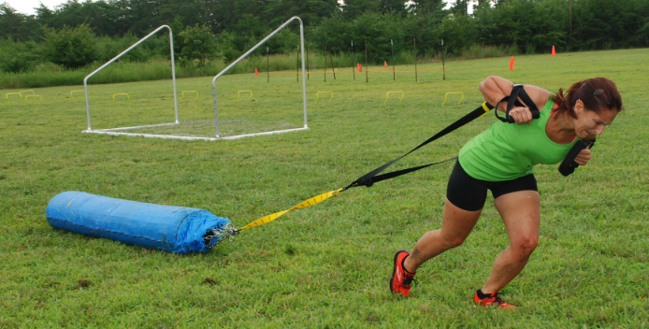
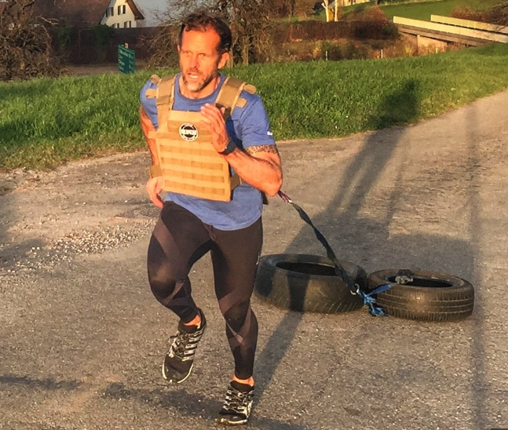
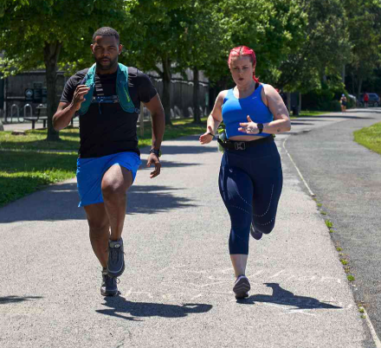

Slide 66
1 John 3:2
My dear friends, we are already God's children, though what we will be hasn't yet been seen. But we do know when Christ returns, we will be like him, because we will see him as he truly is. ³ This hope makes us keep ourselves holy, just as Christ^{[b]} is holy.

Slide 67
When Christ Returns We Get
Revelation 21, 22 A new heaven and earth A crown We get to live in a beautiful holy city with God and Jesus living with us Perpetual 24-hour daylight (no night) no sun or moon; God’s glory provides the light | Free foods that heal us and give us life Rewards for all the good things we have done No more pain, suffering, crying or death,; You get to live forever. Completely surrounded by good people (No bad people around you; they’ll all be outside the city)

Slide 68
2 Tim 4: 7-8 (ICB)
⁷ I have fought the good fight. I have finished the race. I have kept the faith. ⁸ Now, a crown is waiting for me. I will get that crown for being right with God. The Lord is the judge who judges rightly, and he will give me the crown on that Day.^{[a]} He will give that crown not only to me but to all those who have waited with love for him to come again.

Slide 69
CCC Vision
We bring change to the city We show/demonstrate the gospel is ‘good news’ We strive to be holy so others notice we are different We demonstrate what God is like to others by showing them love We accept each other and work as a family. We stay united We worship God with our whole heart, and let him lead us through prayer and reading our bibles | We all do our bit within the family of God and help each other. We do our best to spread the gospel so other can learn about Christ and God’s amazing power. We are confident in what we believe, we read our bibles regularly and explain it to those who want to understand. As our church grows, we stay true to what we believe with no compromise. We keep our eyes on Jesus as we wait for the day that he returns in Glory.

Slide 70
2 Corinthians 14 May the grace of the Lord Jesus Christ, and the love of God, and the fellowship of the Holy Spirit be with you all
Surely goodness and mercy shall follow me all the days of my life, and I shall dwell in the house of the Lord forever.

